Slide 2
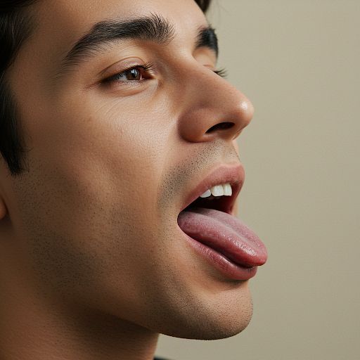
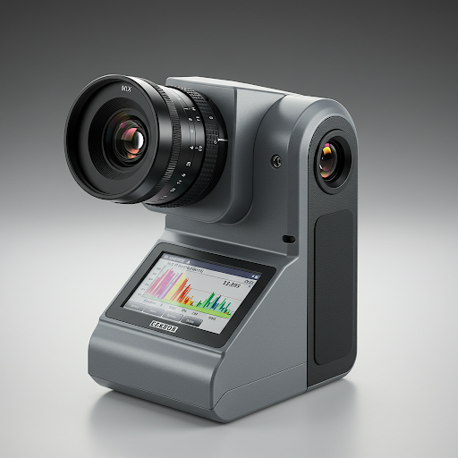
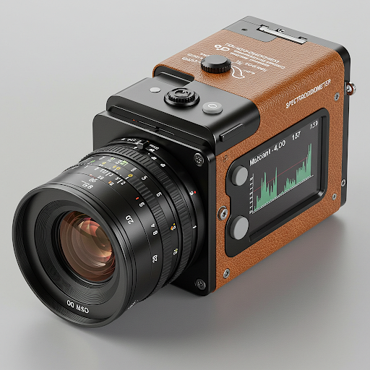

Slide 3

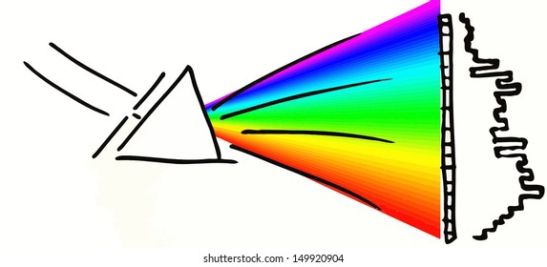
Short (450 nm) pass filter
White surface
Light measurement
Short (450 nm) pass filter
long (475 nm) pass filter
Tongue or Lip
Fluorescence measurement

Slide 5
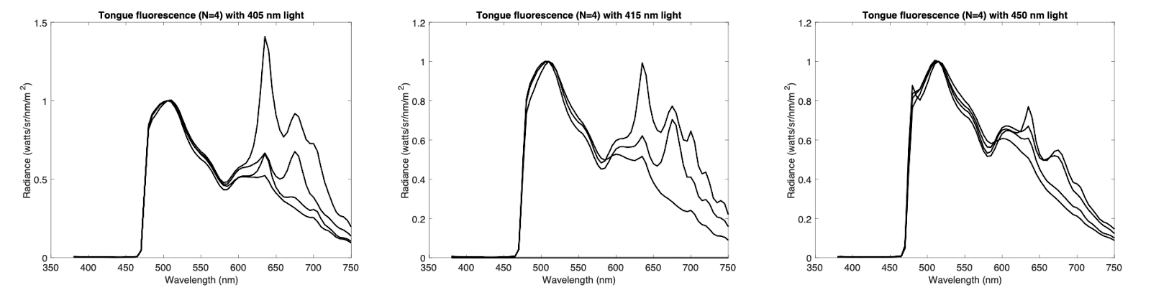
Changes: normalize by dividing by amplitude at 500 nm
Bottom row should be lower lip

